Slide 1
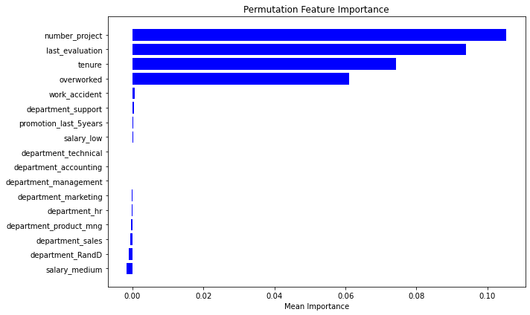
Salifort Motors Project Proposal
Predicting turnover with machine learning
Salifort is experiencing a high employee turnover rate, which includes both voluntary and involuntary departures. This issue is concerning due to the significant investments the company makes in recruiting, training, and developing its workforce.
Turnover is affecting employee satisfaction, company culture, and operational efficiency, while also generating financial costs. Leadership lacks clear insight into the drivers of turnover and how to proactively address them.
A data-driven predictive model can help Salifort identify which employees are most likely to leave and uncover key contributing factors such as satisfaction, workload, and tenure. This approach can help the company take targeted actions to improve retention and reduce costs.
A Random Forest Classifier was selected as the champion model to predict employee departures at Salifort Motors. The model achieved 95% accuracy, with 81% precision and 93% recall, showing it is effective at identifying most employees who leave, though with a moderate rate of false alarms. On the test data, the model produced 86 false positives and 29 false negatives, which is acceptable but can be adjusted based on business priorities.
To understand what drives attrition, we used permutation importance, which highlighted four main drivers of the left variable. First, Number of projects – the most impactful factor, suggesting both overwork and under-challenge can trigger exits. Second, Last evaluation – potentially reflecting dissatisfaction with performance recognition. Third, Tenure – indicating risk may increase at certain stages of the employee lifecycle; and Overworked – a clear sign of possible burnout
Image Alt-Text Here
Monitor and retrain the model periodically to maintain high accuracy as employee data evolves.
Adjust the decision threshold to prioritise precision or recall based on Salifort’s business risk tolerance.
Collaborate with HR to design targeted retention strategies based on key drivers like satisfaction level and workload.

